Slide 1
Is Singapore putting in effort to gear the country towards a sustainable one?
Analysis By: Toh Kien Yu (P2222291)

Slide 2
Roadmap
Nature Of Datasets
Insights from analysis + Data Cleaning
Conclusion
References

Slide 3
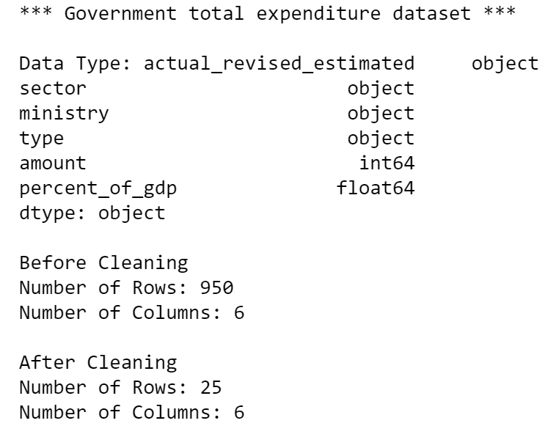
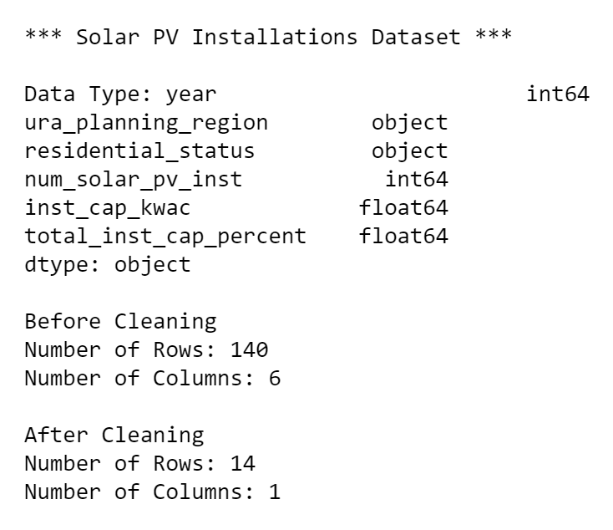
Nature of Dataset (Field Name, Description, Example)
Government total expenditure dataset
Solar PV Installations Dataset
Graph 1
Graph 2

Slide 4
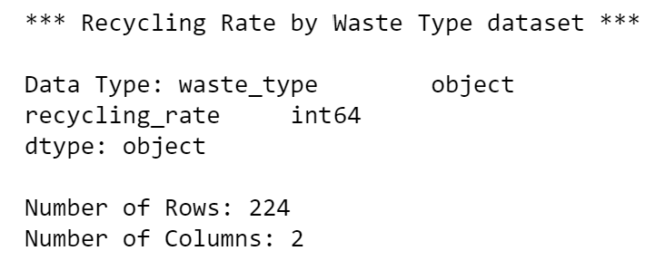
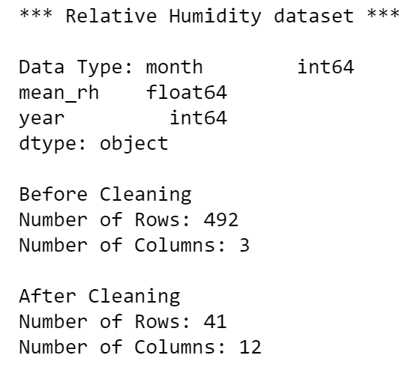
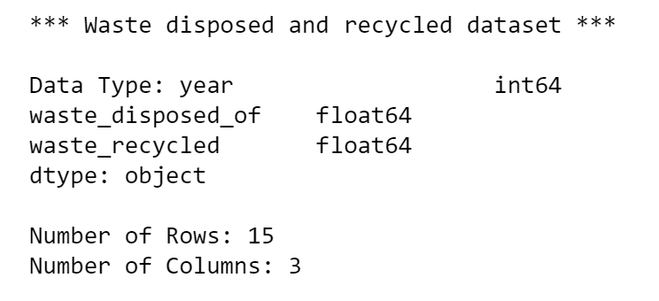
Nature of Dataset (Field Name, Description, Example)
Recycling Rate by Waste Type Dataset
Relative Humidity Dataset
Graph 3
Graph 5
Waste disposed and recycled Dataset
Graph 4

Slide 5
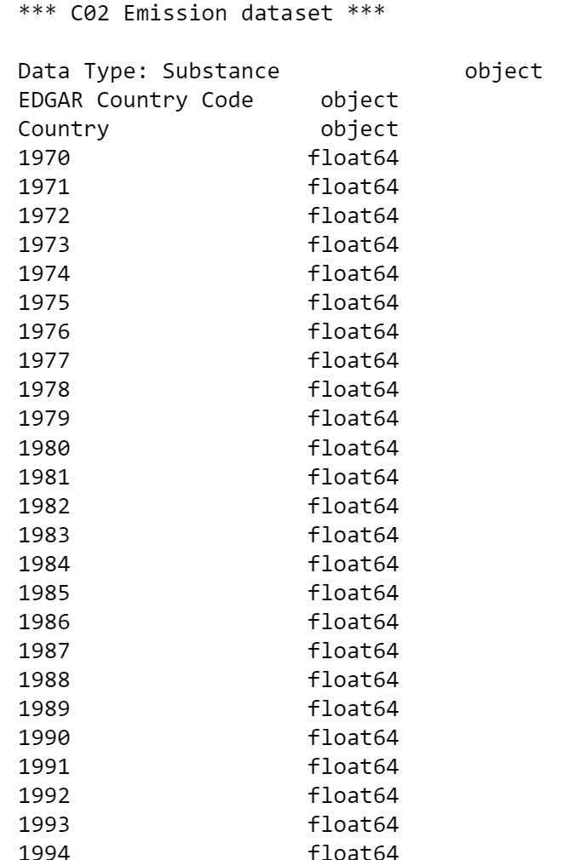
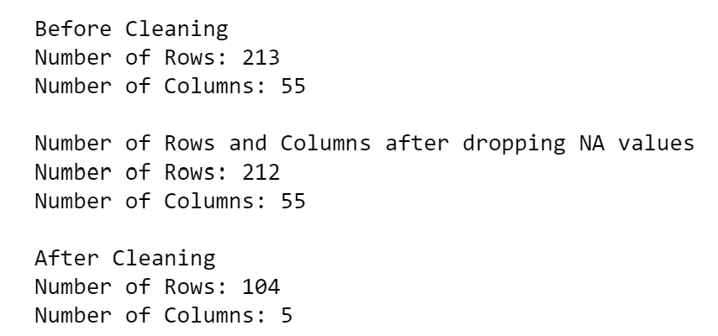
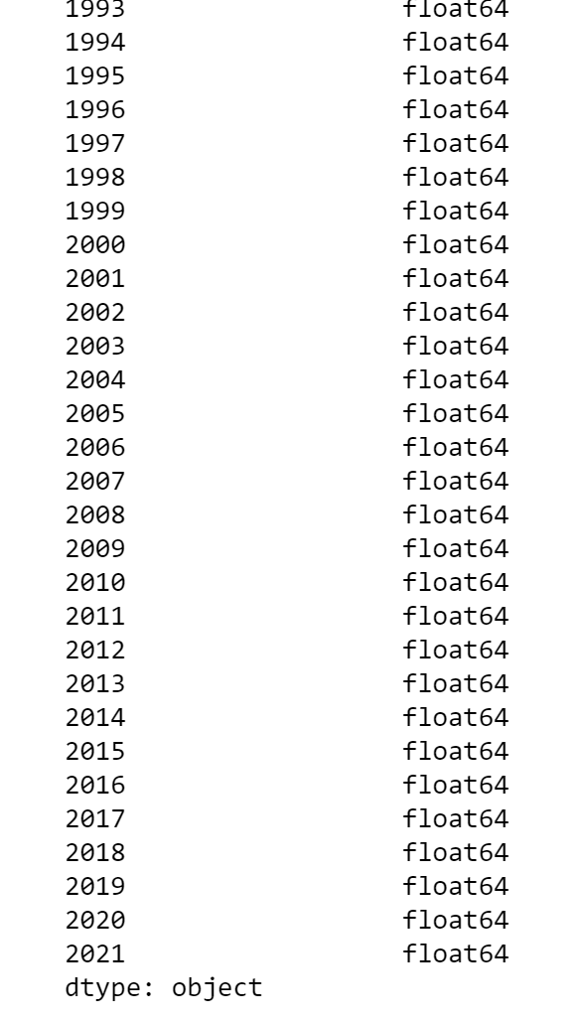
Nature of Dataset (Field Name, Description, Example)
Graph 6
Carbon Dioxide Emission Dataset

Slide 6
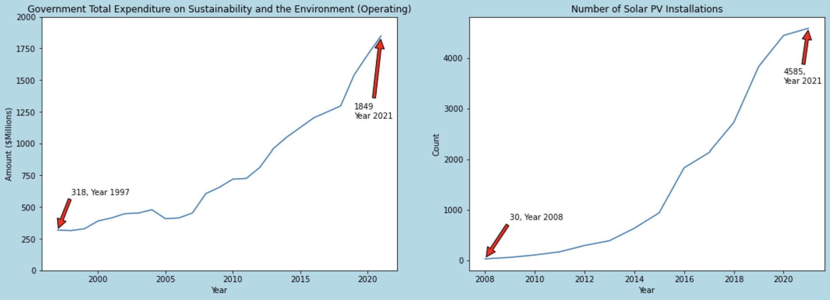
Analysis: Is Singapore putting in effort to gear the country towards a sustainable one?
The expenditure spent by the Singapore Government on Sustainability and Environment (Operating) has increased from $318 Million in 1997 to $1849 Million in 2021 as shown in Graph 1.
The increased expenditure shows that Singapore is recognizing the importance of preserving the environment and are pushing for sustainability efforts.
According to Graph 2, the number of Solar Photovoltaic (Solar PV) Installation increased from 30 units in 2008 to 4585 units in Year 2021
Solar PV is a technology that converts sunlight into electricity. The increase in Solar PV installations suggests that there will be a positive impact towards the environment. Solar PVs are a clean, renewable energy source that do not contaminate the environment.
Hence, Singapore can be less reliant on finite fossil fuels.
Graph 1 Line Chart of
Government Total Expenditure on Sustainability and the Environment (Operating)
Graph 2 Line Chart of
Number of Solar PV Installation

Slide 7
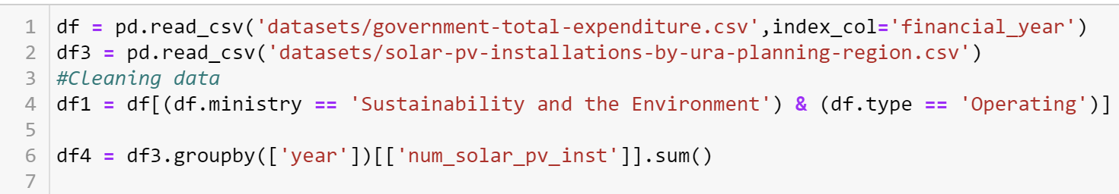
Cleansing of Data: Line Charts
1. Read both datasets
2. Extract only the rows needed for the expenditure dataset
Used for the ‘groupby’ to get sum of solar PV Installation
Plot the Graph

Slide 8
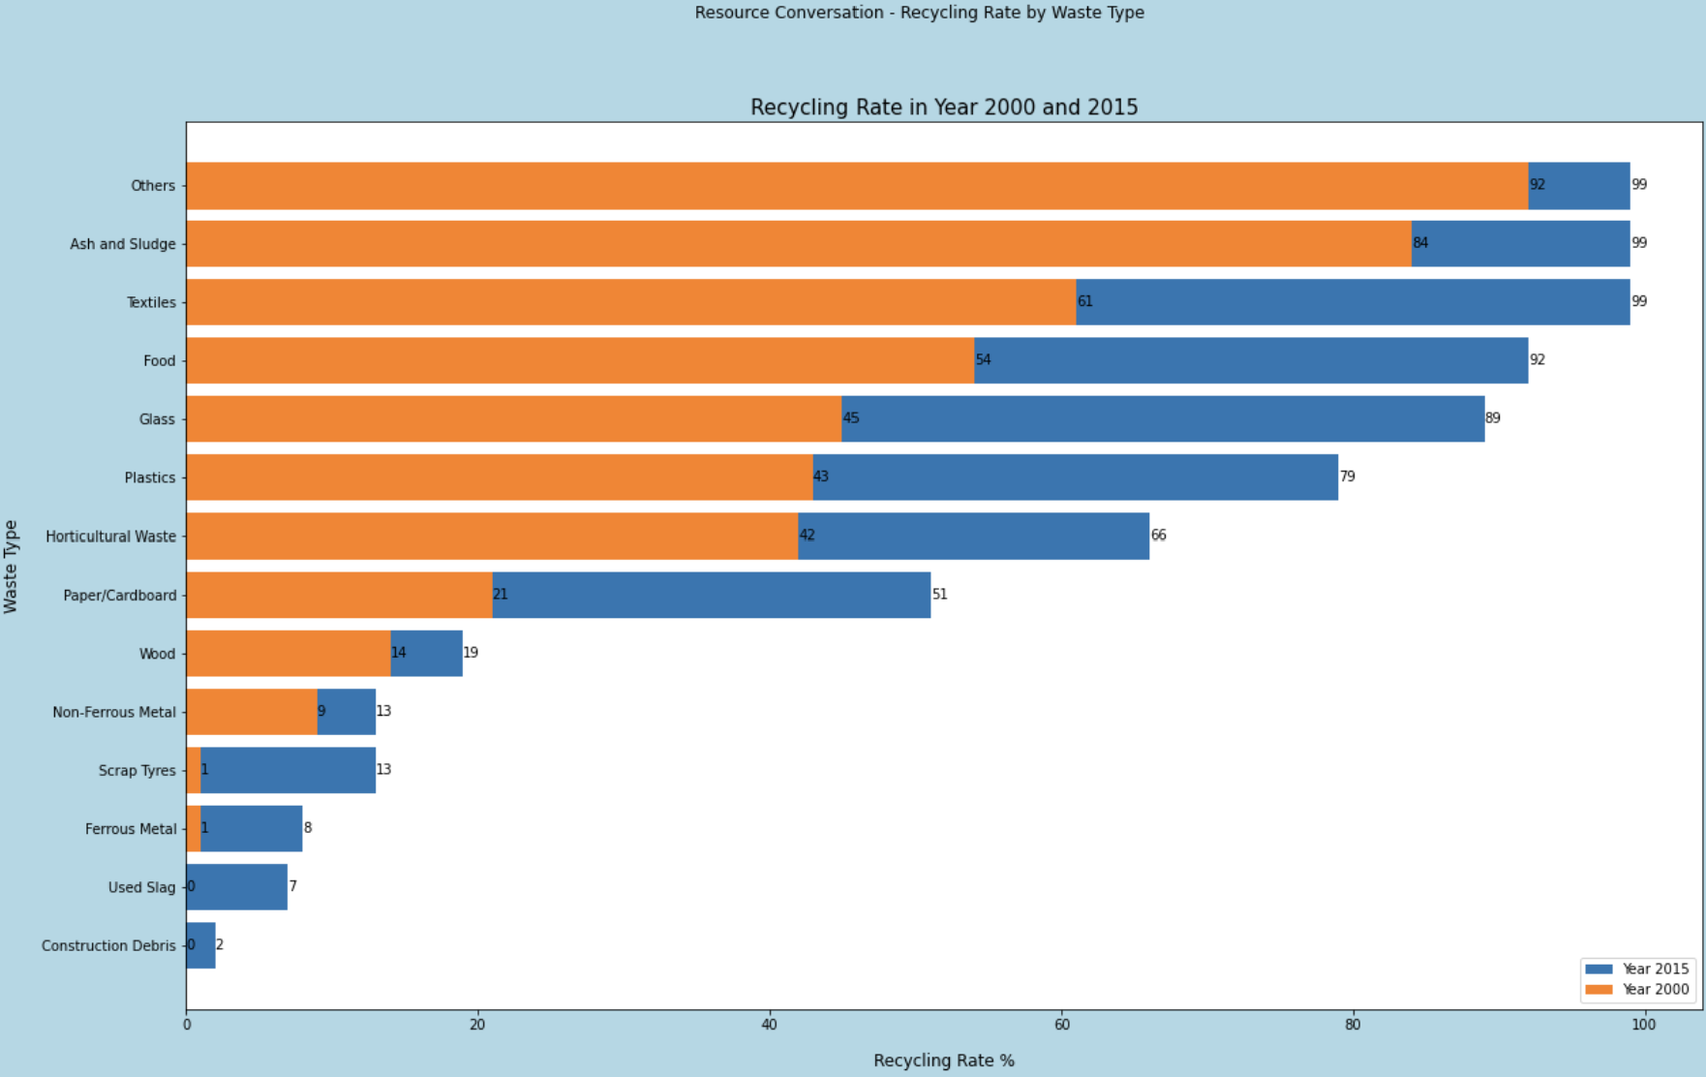
Analysis: Is Singapore putting in effort to gear the country towards a sustainable one?
From 2000 to 2015, recycling rate for nearly all waste types has increased in Singapore.
Out of all categories, the recycling rate of ‘Food, Glass and Plastic’ category has doubled approximately while the ‘Others, Ash & Sludge and Textiles’ increased to 99% recycling rate.
The rise in the nation’s recycling rate shows that the recent efforts done by the Government to promote recycling in households and industries has paid off.
This conclusion is worth noting as recycling not only reduce the amount of wastage that reaches to our landfill but also lower energy consumption and green house gas emissions.
Thus, it is evident that Singapore is putting in effort to attain sustainability.
Graph 3 Stacked Bar Chart of
Recycling Rate

Slide 9
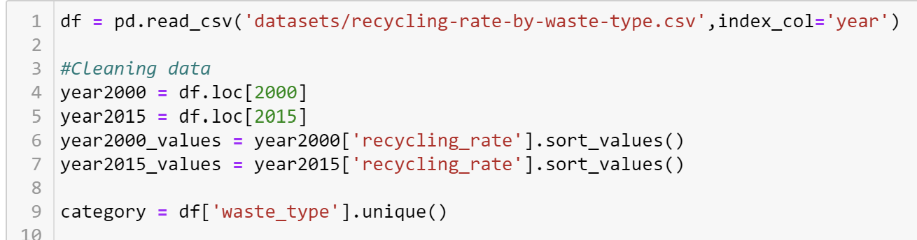
Cleansing of Data: Stacked Bar Chart
Read the dataset
Extract only the Year 2000 and 2015 Rows with .loc
Extract the recycling rate values and sort them from highest to lowest
Extract the categorical values with .unique()
Plot the Graph

Slide 10
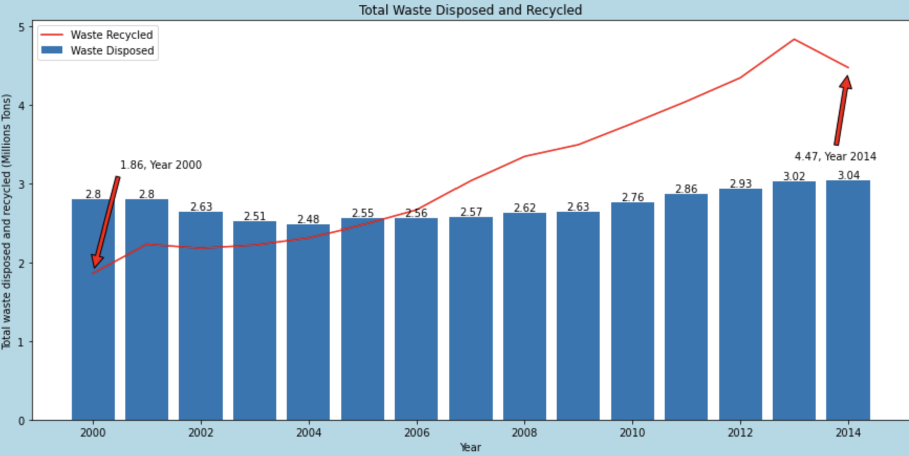
Analysis: Is Singapore putting in effort to gear the country towards a sustainable one?
The total waste recycled increased from 1.86 million tons in year 2000 to 4.47 million tons in year 2014.
On the other hand, the total waste disposal level has fluctuated throughout this period .
In recent years, the trend of upcycling has been going around the society where waste is transformed into something new.
Workshops have been conducted by government bodies in heartlands of Singapore where residents are taught to repurpose unwanted items.
https://centralsingapore.cdc.gov.sg/programmes/wellness-and-sustainability/upcycling-central-singapore/
Graph 4 Bar Line Chart of
Total Waste Disposed and Recycled
Notes:
https://centralsingapore.cdc.gov.sg/programmes/wellness-and-sustainability/upcycling-central-singapore/

Slide 11
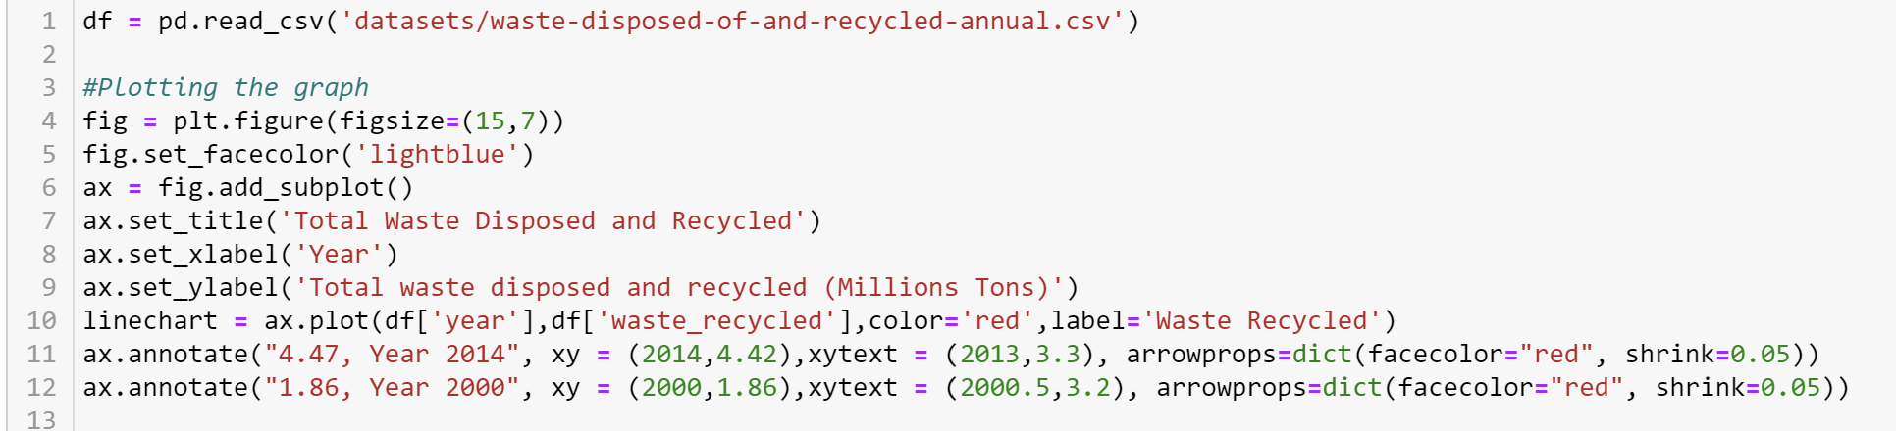
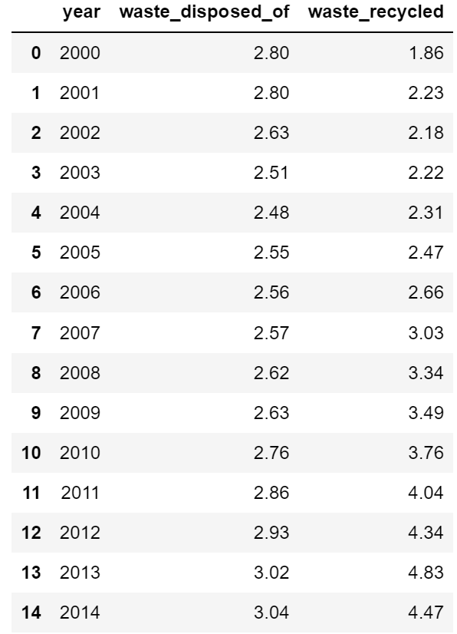
Cleansing of Data: Bar Line Chart
Read the dataset
Able to start Plotting as the data was cleaned enough.

Slide 12
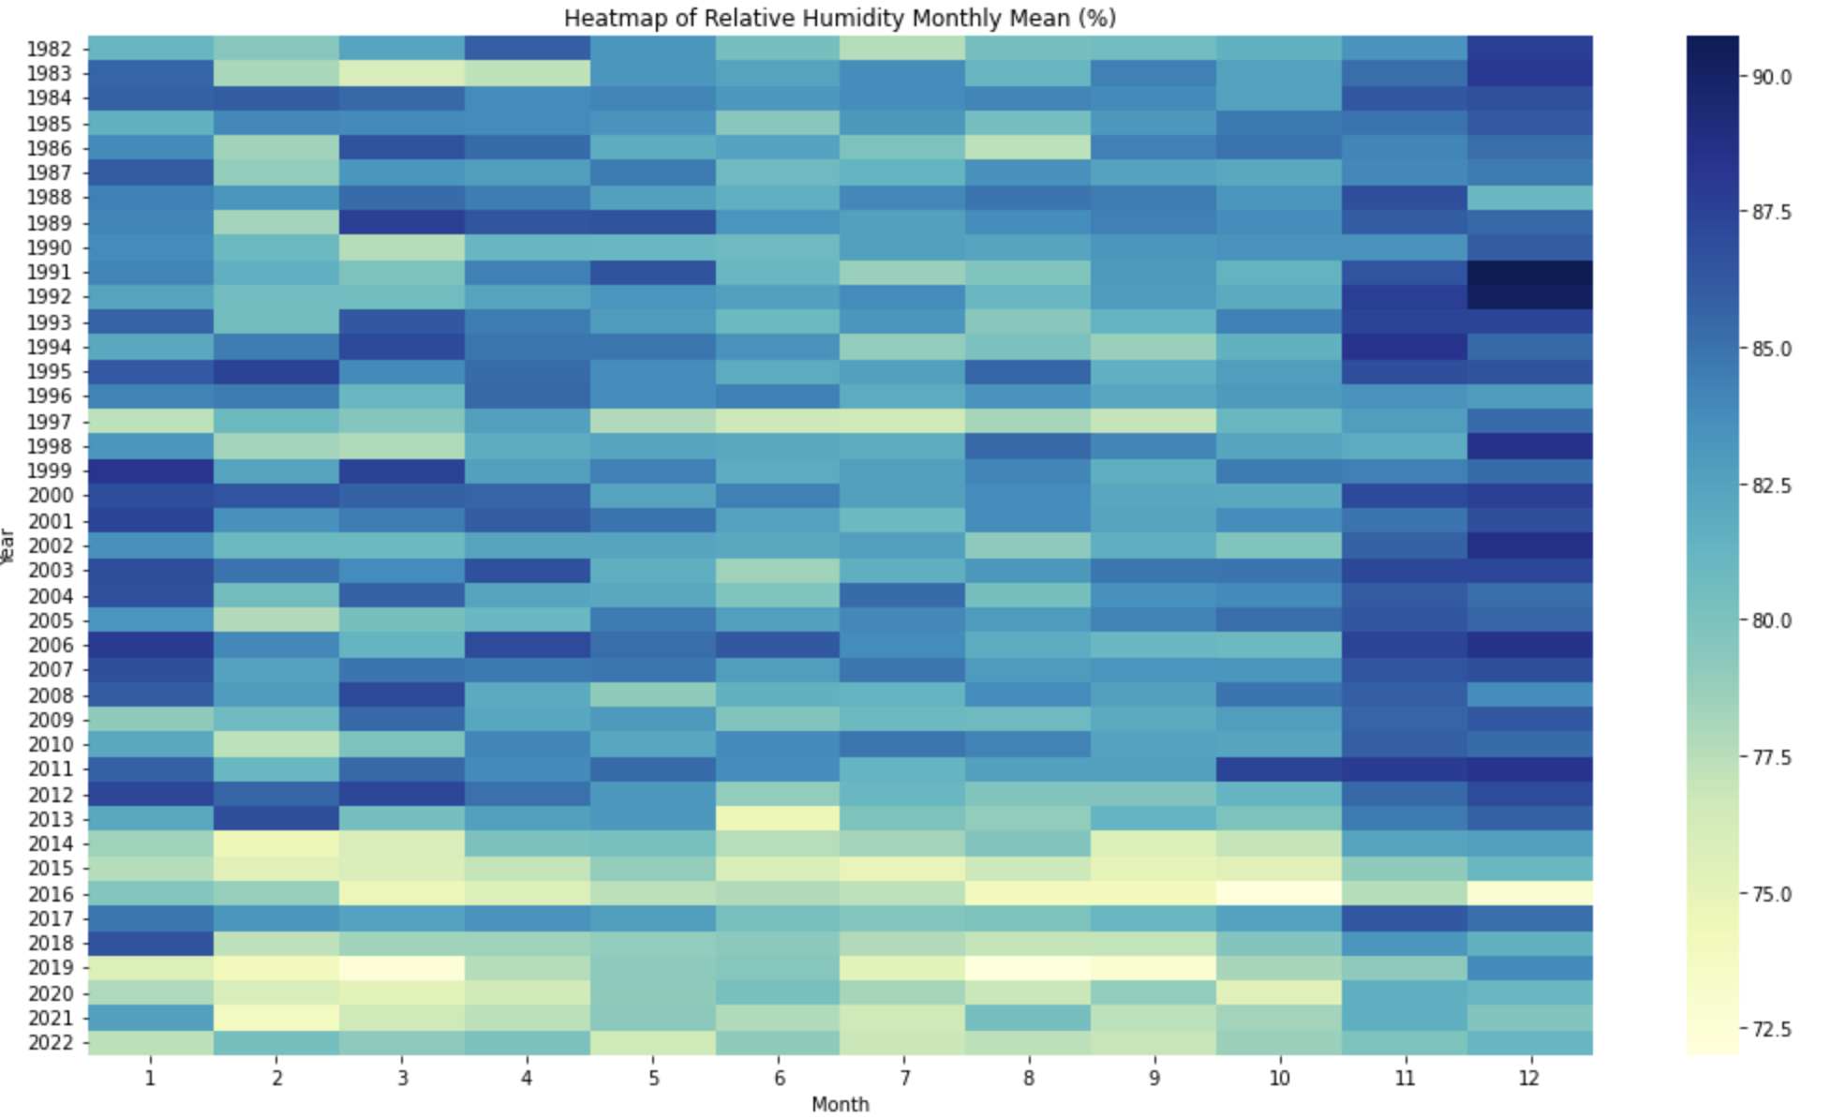
Analysis: Is Singapore putting in effort to gear the country towards a sustainable one?
According to the heatmap plotted, 2022 overall has one of the lowest humidity.
While Singapore has been putting in a significant amount of effort to go sustainable, the environment conditions may limit the effectiveness.
Low humidity can hinder sustainability efforts especially in the area of designing green infrastructure for buildings.
Graph 5 Heatmap of
Relative Humidity Monthly Mean (%)
Notes:
https://sustainabilityworkshop.venturewell.org/node/1194.html

Slide 13
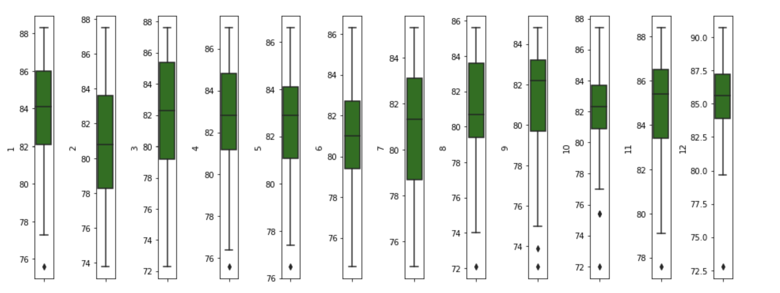
Heatmap Outlier
There are outliers found in the heatmap but not removed as the data serves as trends over the years. Some months encountered a more extreme weather temperature which resulted in a
more extreme humidity

Slide 14
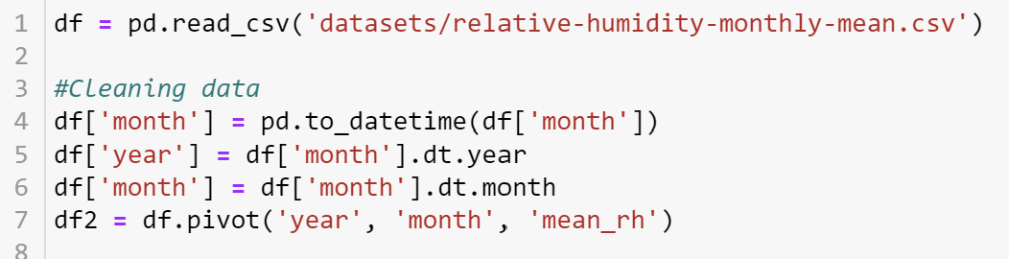
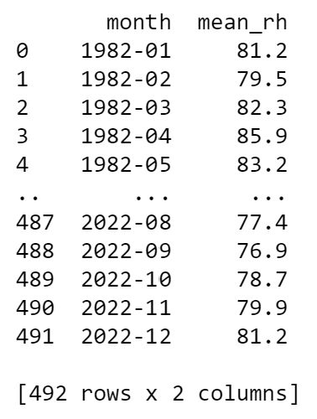
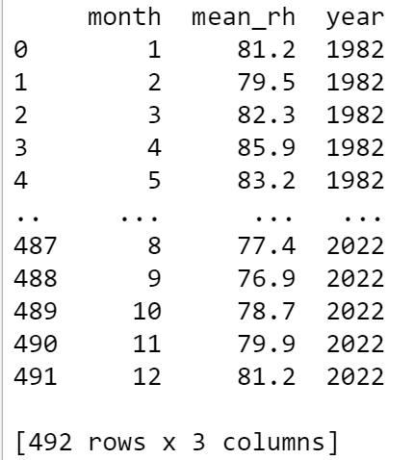
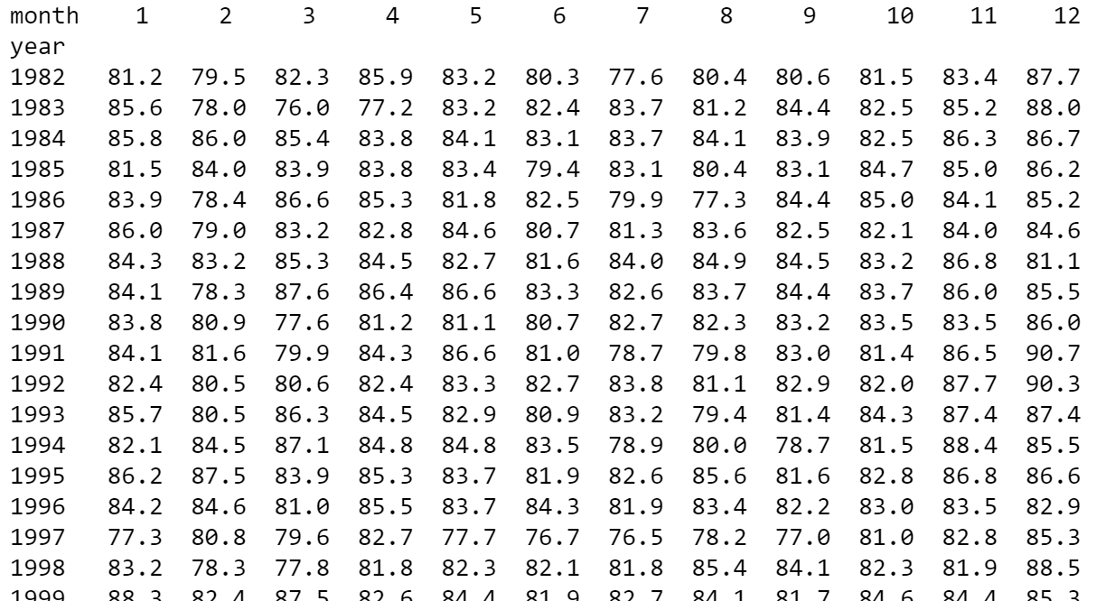
Cleansing of Data: Heatmap
Before:
After:
Read the dataset
Change the data type for ‘month’ column to datetime
Made a Year and Month Column which separates
Pivoted df to plot a heatmap
Plot the heatmap

Slide 15
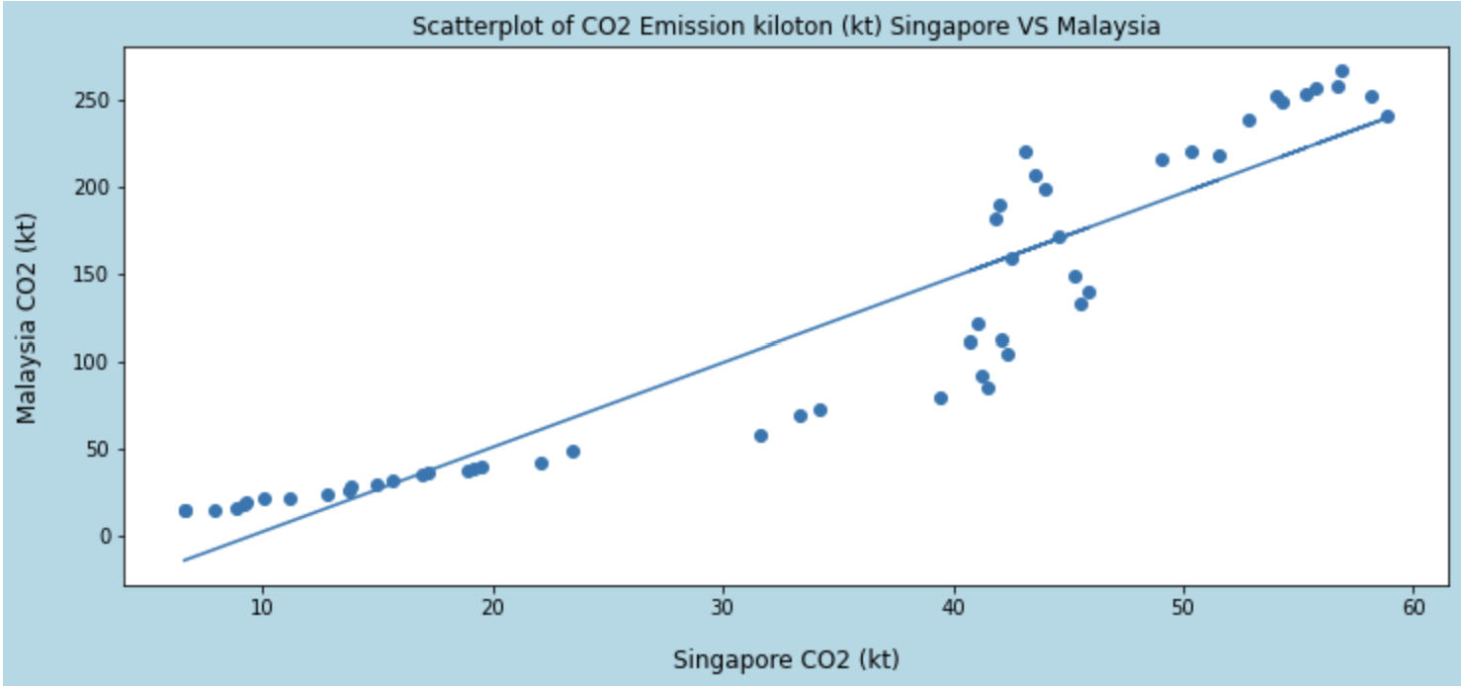
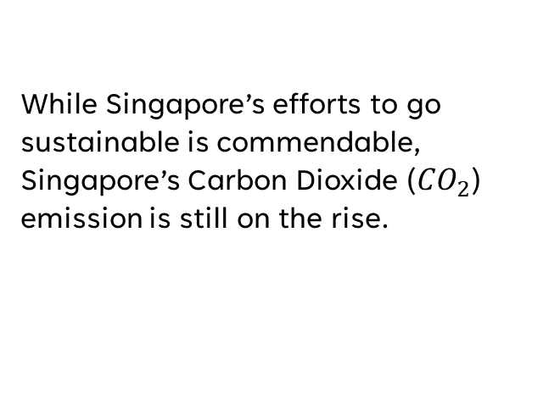
Analysis: Is Singapore putting in effort to gear the country towards a sustainable one?
While Singapore’s efforts to go sustainable is commendable, Singapore’s Carbon Dioxide (${CO}_{2}$) emission is still on the rise.
Graph 6 Scatterplot of
Carbon Dioxide Emission Singapore VS Malaysia

Slide 16
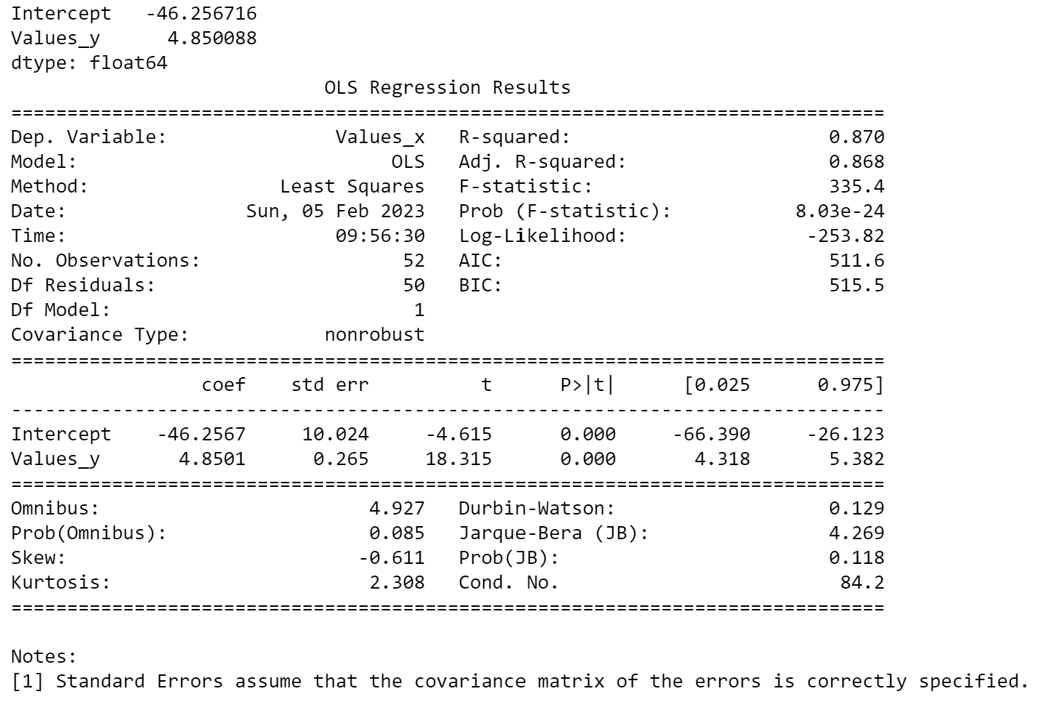
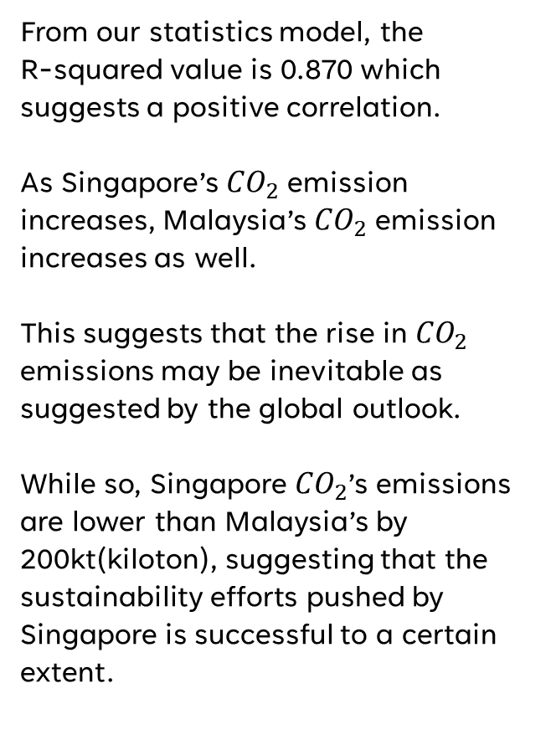
Analysis: Scatterplot
From our statistics model, the
R-squared value is 0.870 which suggests a positive correlation.
As Singapore’s ${CO}_{2}$ emission increases, Malaysia’s ${CO}_{2}$ emission increases as well.
This suggests that the rise in ${CO}_{2}$ emissions may be inevitable as suggested by the global outlook.
While so, Singapore ${CO}_{2}$’s emissions are lower than Malaysia’s by 200kt(kiloton), suggesting that the sustainability efforts pushed by Singapore is successful to a certain extent.

Slide 17
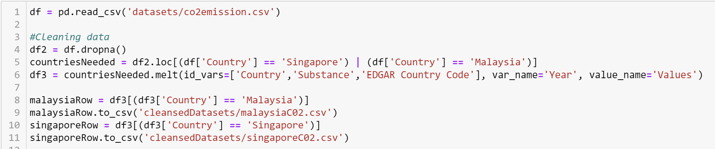
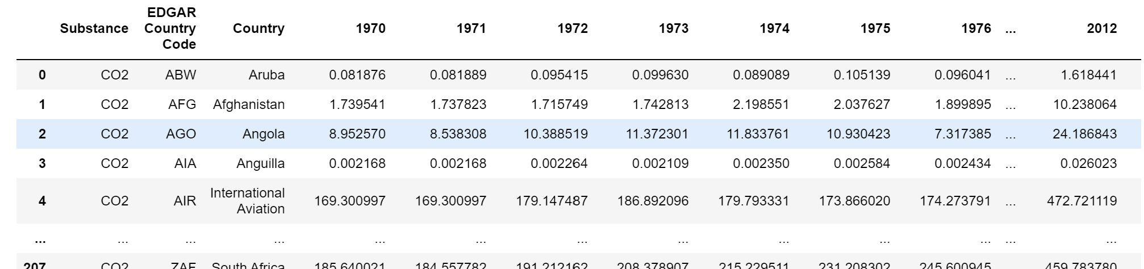
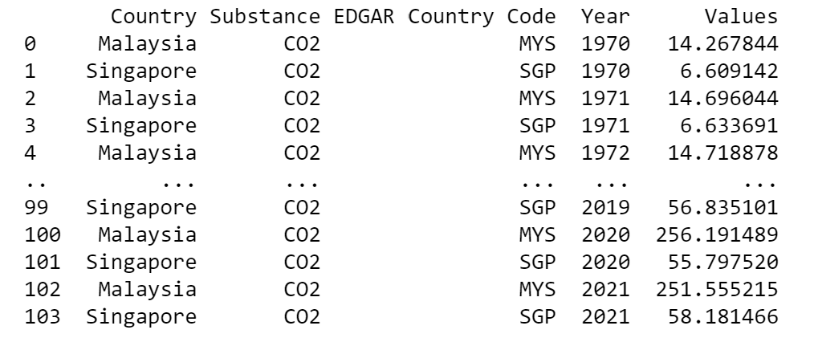
Cleansing of Data: Scatterplot
Df2:
Read the dataset
Drop NA Values using dropna()
Extract only the countries needed, Singapore and Malaysia
Use .melt to make the initial year column to a row.
Extract the rows for each Country
Plot the Scatterplot
Df3:

Slide 18
Conclusion
To summarise my data analysis,
We can conclude that Singapore has placed a big emphasis to push for a Sustainable Singapore. Through encouraging the 3Rs (Recycling, Reuse and Reduce) as well as increasing expenditure for green infrastructure, there have been positive results & feedback shown through statistics and cultural norms.
Recommendation
Moving forward, Singapore can continue to explore other sustainable energy sources so as to reduce our reliance on fossil fuels to the minimal level. Concurrently, there can be public education done to educate the citizens on how to go green and sustainable.
With these forces coming together, it is entirely possible for Singapore to be a leading sustainable country.

Slide 19
References
Government Total Expenditure Dataset: https://data.gov.sg/dataset/government-fiscal-position-annual?resource_id=7b4af397-3e8f-40de-9208-90d168afc810
Solar PV Installation Dataset: https://data.gov.sg/dataset/solar-pv-installations-by-ura-planning-region
Recycling Rate by Waste Type Dataset: https://data.gov.sg/dataset/resource-conservation-recycling-rate-by-waste-type
Waste Disposed and Recycled Dataset: https://data.gov.sg/dataset/waste-disposed-of-and-recycled-annual
Relative Humidity Dataset: https://data.gov.sg/dataset/relative-humidity-monthly-mean
Carbon Dioxide Emission Dataset: https://edgar.jrc.ec.europa.eu/report_2022

Slide 20
Thank You!

